Slide 1
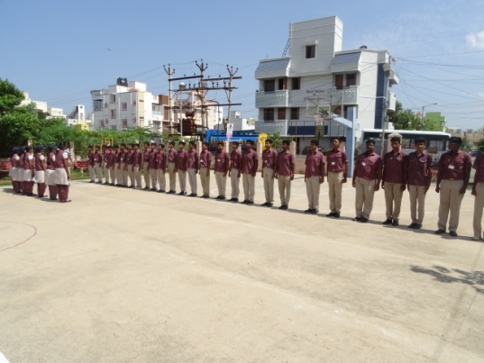
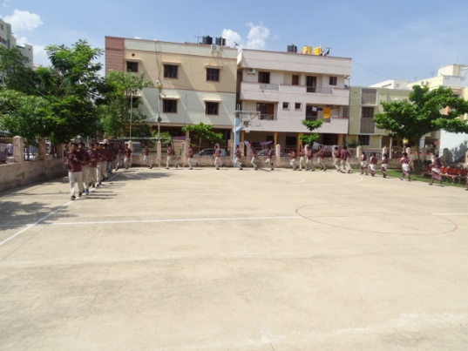
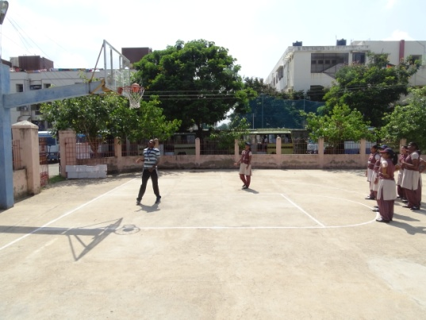
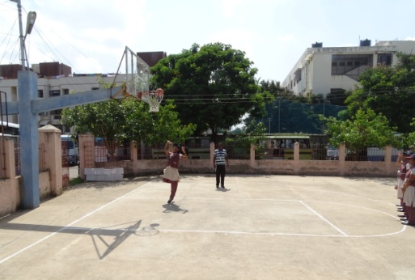
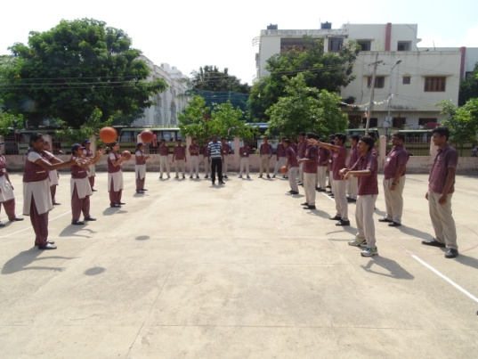
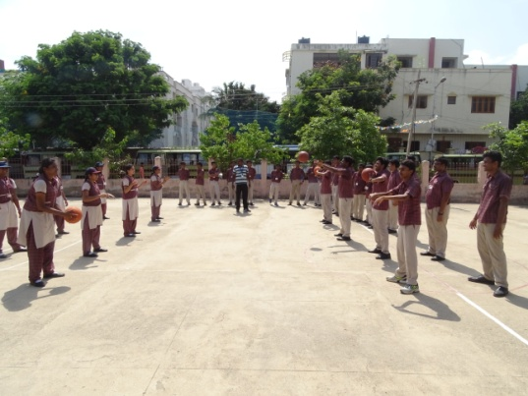
CLASS : XII D
DATE: 14.06.18
BASKET BALL IN ACTION AT BASKET BALL COURT
Assembly and Roll Call
Warming up
Teaching Shooting Skill
Practising Shooting Skill
Teaching & Practising Passing Skill

